Slide 1
Floyd’s Algorithm
All pairs shortest path
Floyd’s Algorithm <number>
Notes:
Algorithms
CS333 / class 22

Slide 2
All pairs shortest path
The problem: find the shortest path between every pair of vertices of a graph
The graph: may contain negative edges but no negative cycles
A representation: a weight matrix where
W(i,j)=0 if i=j.
W(i,j)=∞ if there is no edge between i and j.
W(i,j)=“weight of edge”
Note: we have shown principle of optimality applies to shortest path problems
Floyd’s Algorithm <number>
Notes:
Algorithms
CS333 / class 22

Slide 3
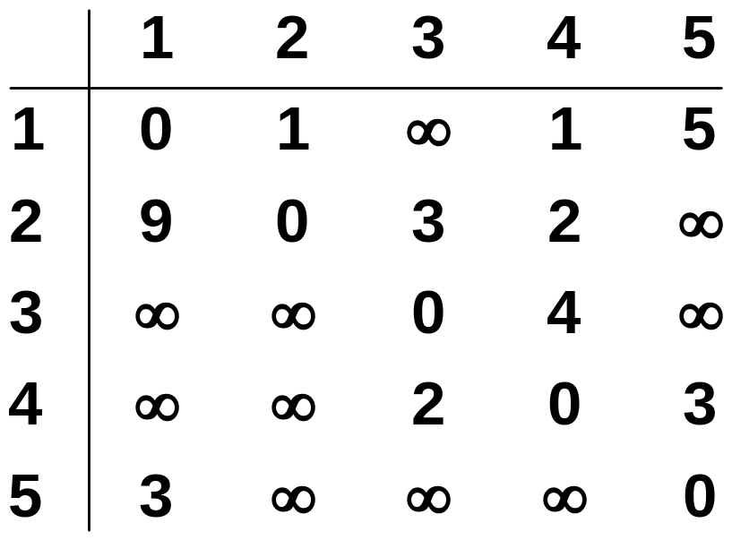
The weight matrix and the graph
1
3
v₁
v₂
9
5
1
2
3
v₅
3
2
v₄
v₃
4
Floyd’s Algorithm <number>
Notes:
Algorithms
CS333 / class 22

Slide 4
The subproblems
How can we define the shortest distance d_{i,j} in terms of “smaller” problems?
One way is to restrict the paths to only include vertices from a restricted subset.
Initially, the subset is empty.
Then, it is incrementally increased until it includes all the vertices.
Floyd’s Algorithm <number>
Notes:
Algorithms
CS333 / class 22

Slide 5
The subproblems
Let D^{(k)}[i,j]=weight of a shortest path from v_{i} to v_{j} using only vertices from {v₁,v₂,…,v_{k}} as intermediate vertices in the path
  D⁽⁰⁾=W
  D^{(n)}=D which is the goal matrix
How do we compute D^{(k)} from D^{(k-1)} ?
Floyd’s Algorithm <number>
Notes:
Algorithms
CS333 / class 22

Slide 6
The Recursive Definition:
Case 1: A shortest path from v_{i} to v_{j} restricted to using only vertices from {v₁,v₂,…,v_{k}} as intermediate vertices does not use v_{k}. Then D^{(k)}[i,j]= D^{(k-1)}[i,j].
Case 2: A shortest path from v_{i} to v_{j} restricted to using only vertices from {v₁,v₂,…,v_{k}} as intermediate vertices does use v_{k}. Then D^{(k)}[i,j]= D^{(k-1)}[i,k]+ D^{(k-1)}[k,j].
Shortest path using intermediate vertices
{V₁, . . . V_{k} }
V_{k}
V_{j}
V_{i}
Shortest Path using intermediate vertices { V_{1, . . .} V_{k -1} }
Floyd’s Algorithm <number>
Notes:
Algorithms
CS333 / class 22

Slide 7
The recursive definition
Since
D^{(k)}[i,j]= D^{(k-1)}[i,j] or
D^{(k)}[i,j]= D^{(k-1)}[i,k]+ D^{(k-1)}[k,j].
We conclude:
D^{(k)}[i,j]= min{ D^{(k-1)}[i,j], D^{(k-1)}[i,k]+ D^{(k-1)}[k,j] }.
Shortest path using intermediate vertices
{V₁, . . . V_{k} }
V_{k}
V_{j}
V_{i}
Shortest Path using intermediate vertices { V_{1, . . .} V_{k -1} }
Floyd’s Algorithm <number>
Notes:
Algorithms
CS333 / class 22

Slide 8
The pointer array P
Used to enable finding a shortest path
Initially the array contains 0
Each time that a shorter path from i to j is found the k that provided the minimum is saved (highest index node on the path from i to j)
To print the intermediate nodes on the shortest path a recursive procedure that print the shortest paths from i and k, and from k to j can be used
Floyd’s Algorithm <number>
Notes:
Algorithms
CS333 / class 22

Slide 9
Floyd's Algorithm Using n+1 D matrices
Floyd//Computes shortest distance between all pairs of //nodes, and saves P to enable finding shortest paths
1. D⁰ ← W // initialize D array to W [ ]
2. P ← 0 // initialize P array to [0]
3. for k ← 1 to n
4. do for i ← 1 to n
5. do for j ← 1 to n
6. if (D^{k-1}[ i, j ] > D^{k-1} [ i, k ] + D^{k-1} [ k, j ] )
7. then D^{k}[ i, j ] ← D^{k-1} [ i, k ] + D^{k-1} [ k, j ]
8. P[ i, j ] ← k;
9. else D^{k}[ i, j ] ← D^{k-1} [ i, j ]
Floyd’s Algorithm <number>
Notes:
Algorithms
CS333 / class 22

Slide 10
Example
1
2
3
1
0
4
5
W = D⁰ =
1
2
2
0
∞
5
3
∞
-3
0
4
2
3
1
2
3
2
-3
1
0
0
0
P =
2
0
0
0
3
0
0
0
Floyd’s Algorithm <number>
Notes:
Algorithms
CS333 / class 22

Slide 11
k = 1
Vertex 1 can be intermediate node
1
1
2
3
5
D⁰ =
1
0
4
5
4
2
3
2
2
0
∞
2
-3
3
∞
-3
0
1
2
3
1
0
4
5
D¹[2,3] = min( D⁰[2,3], D⁰[2,1]+D⁰[1,3] )
= min (∝, 7)
= 7
D¹[3,2] = min( D⁰[3,2], D⁰[3,1]+D⁰[1,2] )
= min (-3,∝)
= -3
D¹ =
2
2
0
7
3
∞
-3
0
1
2
3
1
0
0
0
P =
2
0
0
1
3
0
0
0
Floyd’s Algorithm <number>
Notes:
Algorithms
CS333 / class 22

Slide 12
k = 2
Vertices 1, 2 can be intermediate
1
2
3
1
5
D¹ =
1
0
4
5
4
2
3
2
2
0
7
2
-3
3
∞
-3
0
1
2
3
1
0
4
5
D²[1,3] = min( D¹[1,3], D¹[1,2]+D¹[2,3] )
= min (5, 4+7)
= 5
D²[3,1] = min( D¹[3,1], D¹[3,2]+D¹[2,1] )
= min (∝, -3+2)
= -1
D² =
2
2
0
7
3
-1
-3
0
1
2
3
1
0
0
0
P =
2
0
0
1
3
2
0
0
Floyd’s Algorithm <number>
Notes:
Algorithms
CS333 / class 22

Slide 13
k = 3
Vertices 1, 2, 3 can be intermediate
1
1
2
3
5
D² =
1
0
4
5
3
4
2
2
2
0
7
2
-3
3
-1
-3
0
1
2
3
1
0
2
5
D³ =
D³[1,2] = min(D²[1,2], D²[1,3]+D²[3,2] )
= min (4, 5+(-3))
= 2
D³[2,1] = min(D²[2,1], D²[2,3]+D²[3,1] )
= min (2, 7+ (-1))
= 2
2
2
0
7
3
-1
-3
0
1
2
3
1
0
3
0
P =
2
0
0
1
3
2
0
0
Floyd’s Algorithm <number>
Notes:
Algorithms
CS333 / class 22

